Slide 1

RICE GRAIN CLASSIFICATION USING CNN
BY NITHYA SANTHOSHINI KANDULA
BATCH: 263
01

Slide 2

ABOUT ME
NAME : NITHYA SANTHOSHINI K
EDUCATION: BTECH , CSE 23
BACKGROUND:
Recent B.Tech graduate in Computer Science.
Strong interest in data analytics, software development, and cloud engineering.
WHY DATA SCIENCE:
Passionate about learning and exploring the vast domain of Data Science.
Excited to leverage skills in cloud engineering, data analytics, and software development.
WORK EXPERIENCE:
Currently gaining practical exposure at Innomatics Research Labs.
Eager to further my career and make meaningful contributions in Data Science.
02

Slide 3
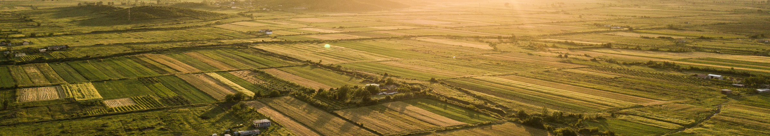
AGENDA
Introduction - Objective and Importance
Dataset Overview
Exploratory Data Analysis (EDA)
Train-Test Split
Data Augmentation
Introduction to CNN
7. CNN and Its Architecture
8. Training Model
9. Model Summary
10. Model Evaluation
11. Predictions
12. Conclusion
03

Slide 4
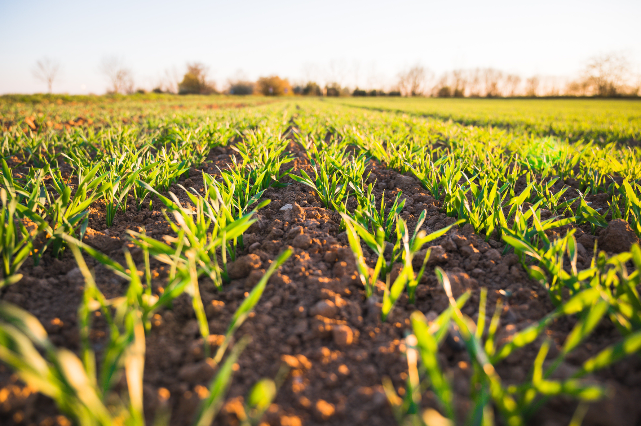
INTRODUCTION
OBJECTIVE:
The goal of this project is to classify rice seeds into their respective types based on image data.
The classification involves distinguishing among different rice varieties: Arborio, Basmati, Ipsala, Jasmine, and Karacadag.
01
IMPORTANCE:
Accurate classification of rice seeds is crucial for quality control in agriculture.
It helps in ensuring the right type of rice is used for specific purposes and can enhance supply chain management and consumer satisfaction.
02
04

Slide 5
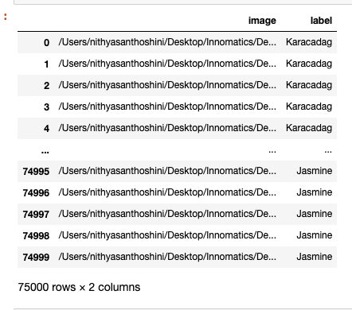
DATASET OVERVIEW
DESCRIPTION:
The dataset comprises images of different types of rice seeds, which are categorized into five classes: Arborio, Basmati, Ipsala, Jasmine, and Karacadag.
DATA SOURCE:
The data was sourced from Kaggle and includes a diverse set of images representing each rice type.
05

Slide 6
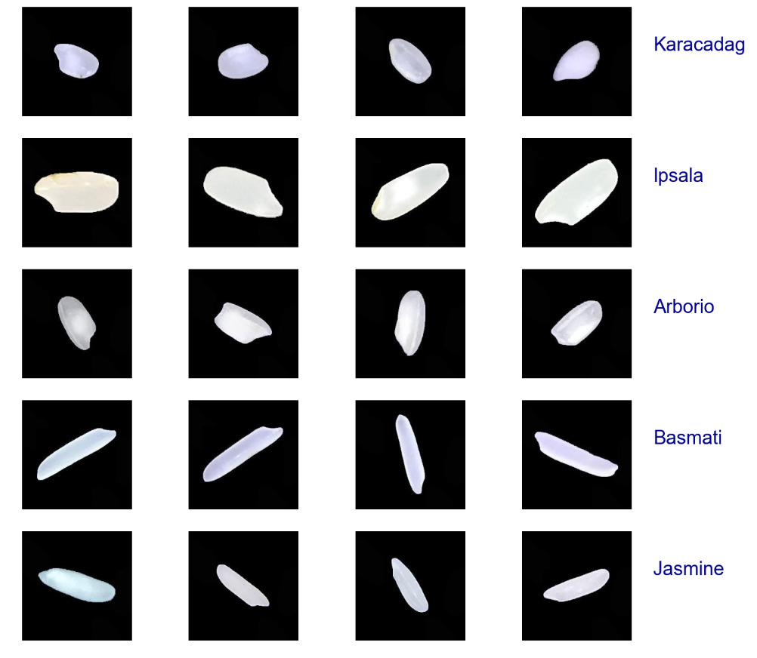
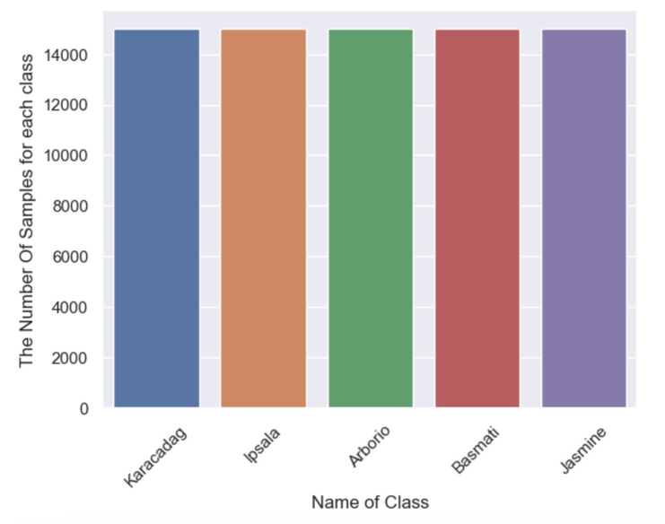
EXPLORATORY DATA ANALYSIS (EDA)
Key Insights:
The dataset is balanced with a representative number of images for each rice type.
The images vary in size and background, which may affect model performance.
06

Slide 7
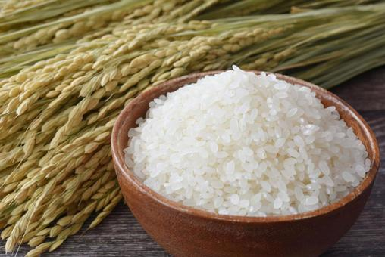
TRAIN-TEST SPLIT
Data Splitting:
Training Dataset: Consists of 80% of the total data.
Testing Dataset: Contains the remaining 20% of the data.
Label Encoding:
Labels were encoded using LabelEncoder to convert rice types ('Arborio', 'Basmati', 'Ipsala', 'Jasmine', 'Karacadag') into numerical values. This allows the model to process categorical labels effectively during training.
07

Slide 8
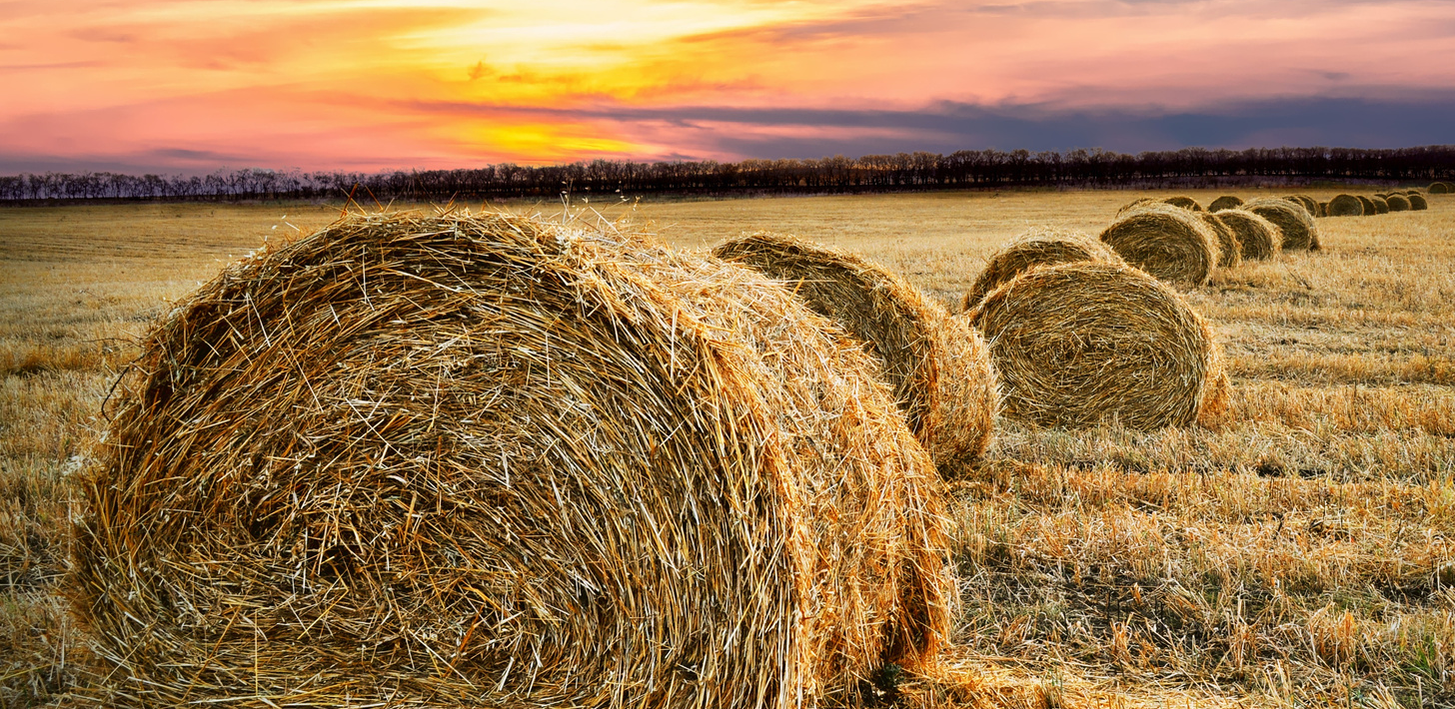
DATA AUGMENTATION
Preprocessing Steps:
Generators: Created data generators for efficient handling of training and testing datasets.
Augmentation Techniques: Applied transformations such as rotation, scaling, and flipping to the training images. This helps in increasing the variability of the data and improving model robustness.
Image Resizing: Reshaped all images to a uniform size of 50x50 pixels to ensure consistency across the dataset.
08

Slide 9
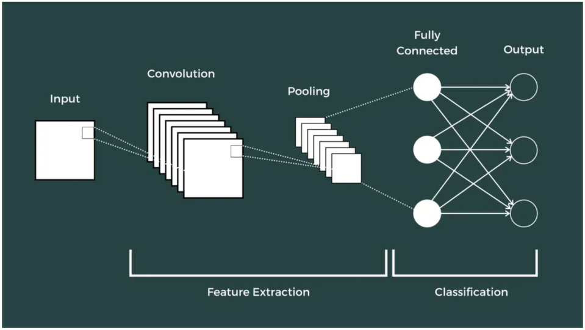
INTRODUCTION TO CNN
Overview:
Convolutional Neural Network is a specialized neural network designed for visual data, such as images & videos. But CNNs also work well for non-image data (especially in NLP & text classification).
Input Layer: Takes images resized to 50x50 pixels.
Convolutional Layers: Detect features from the images.
Pooling Layers: Reduce the spatial dimensions of feature maps.
Flatten Layer: Converts 2D feature maps to 1D.
Dense Layers: Perform classification based on extracted features.
Output Layer: Produces probabilities for each class.
Why CNNs:
CNNs are well-suited for image classification tasks because they can capture complex patterns and features from images through their hierarchical architecture.
09

Slide 10
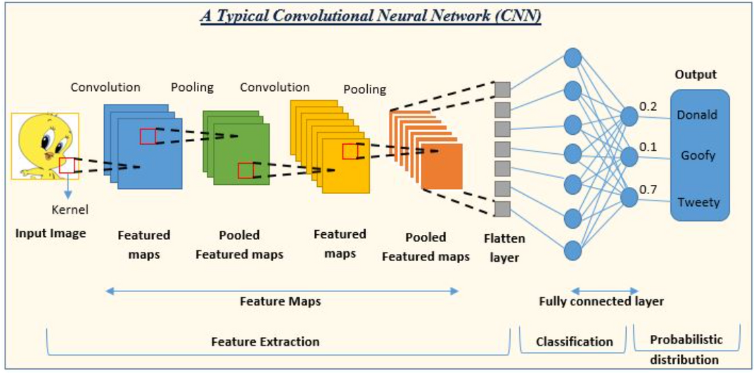
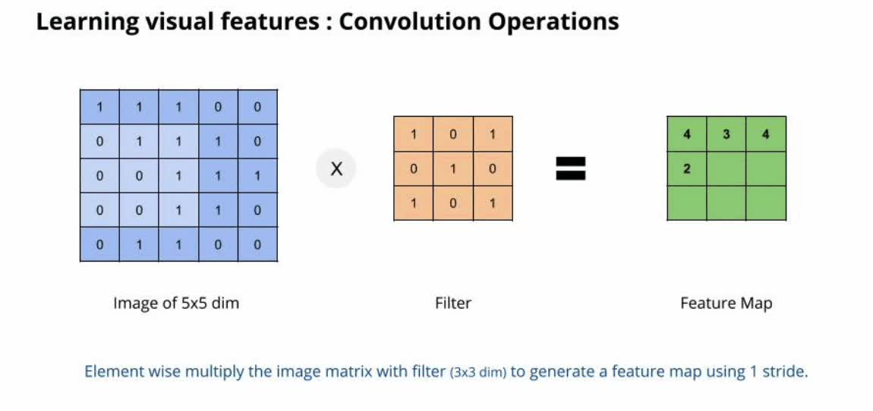
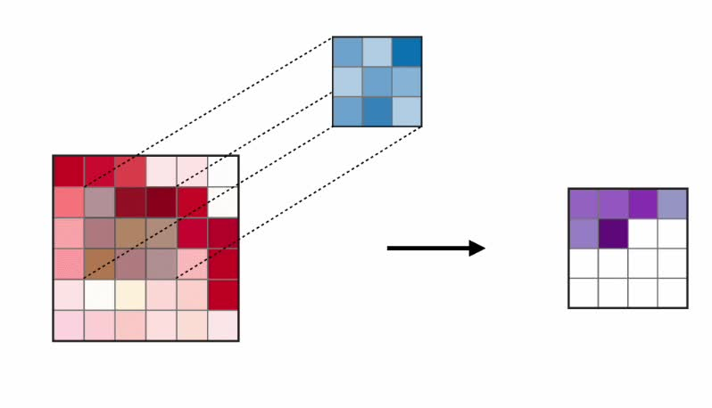
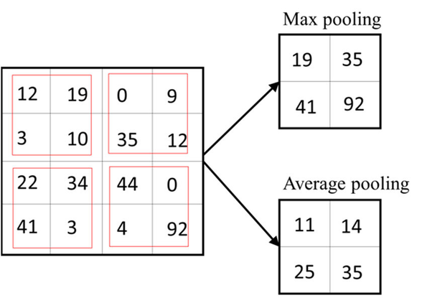

CNN ARCHITECTURE
10

Slide 11
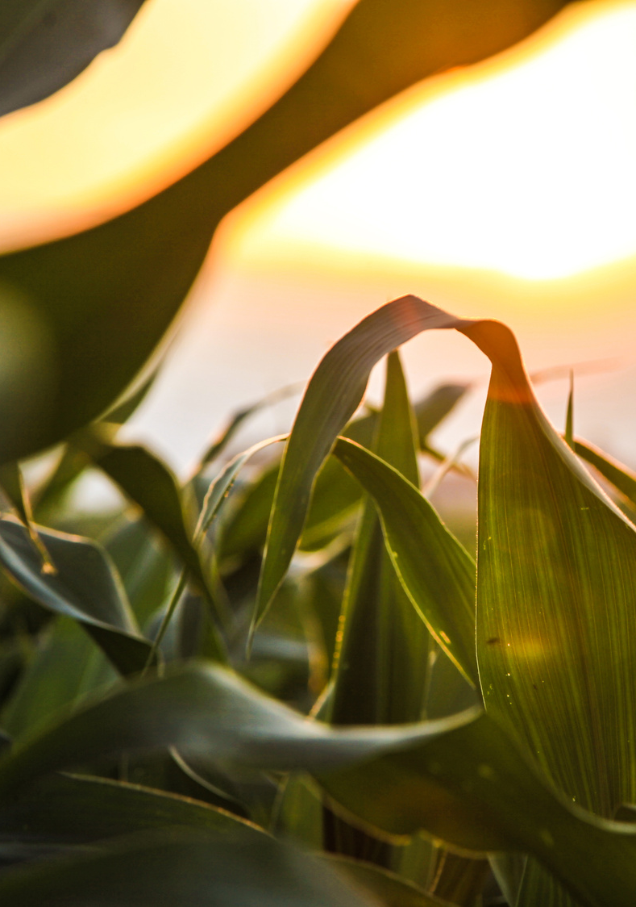
CNN OVERVIEW
FULLY CONNECTED (DENSE) LAYER:
A layer where each neuron is connected to every neuron in the previous layer.
Purpose: To perform high-level reasoning and classification based on the features extracted by convolutional and pooling layers.
CONVOLUTIONAL LAYER:
A layer that applies a set of filters (kernels) to the input image to extract features such as edges, textures, and patterns.
Purpose: To capture local dependencies and reduce the dimensionality of the input data.
04
01
OPTIMIZER:
An algorithm used to adjust the weights of the network during training to minimize the loss function.
Example: Adam optimizer combines the advantages of two other optimizers: AdaGrad and RMSProp.
POOLING LAYER:
A layer that reduces the spatial dimensions (height and width) of the feature maps while retaining important information. and types:
Max Pooling: Selects the maximum value from a feature map segment.
Average Pooling: Computes the average value from a feature map segment.
Purpose: To reduce computational complexity and prevent overfitting by down-sampling.
05
02
ACTIVATION FUNCTION:
A function applied to the output of a neuron to introduce non-linearity into the model and type are :
ReLU (Rectified Linear Unit): Activates only positive values, setting negative values to zero.
Softmax: Converts logits (raw prediction scores) into probabilities.
06
FLATTEN LAYER:
A layer that converts the 2D feature maps into a 1D vector.
Purpose: To prepare the data for input into fully connected (dense) layers.
LOSS FUNCTION:
A function that measures the discrepancy between the predicted output and the actual target values.
Example: Categorical Crossentropy is used for multi-class classification problems.
03
07
11

Slide 12
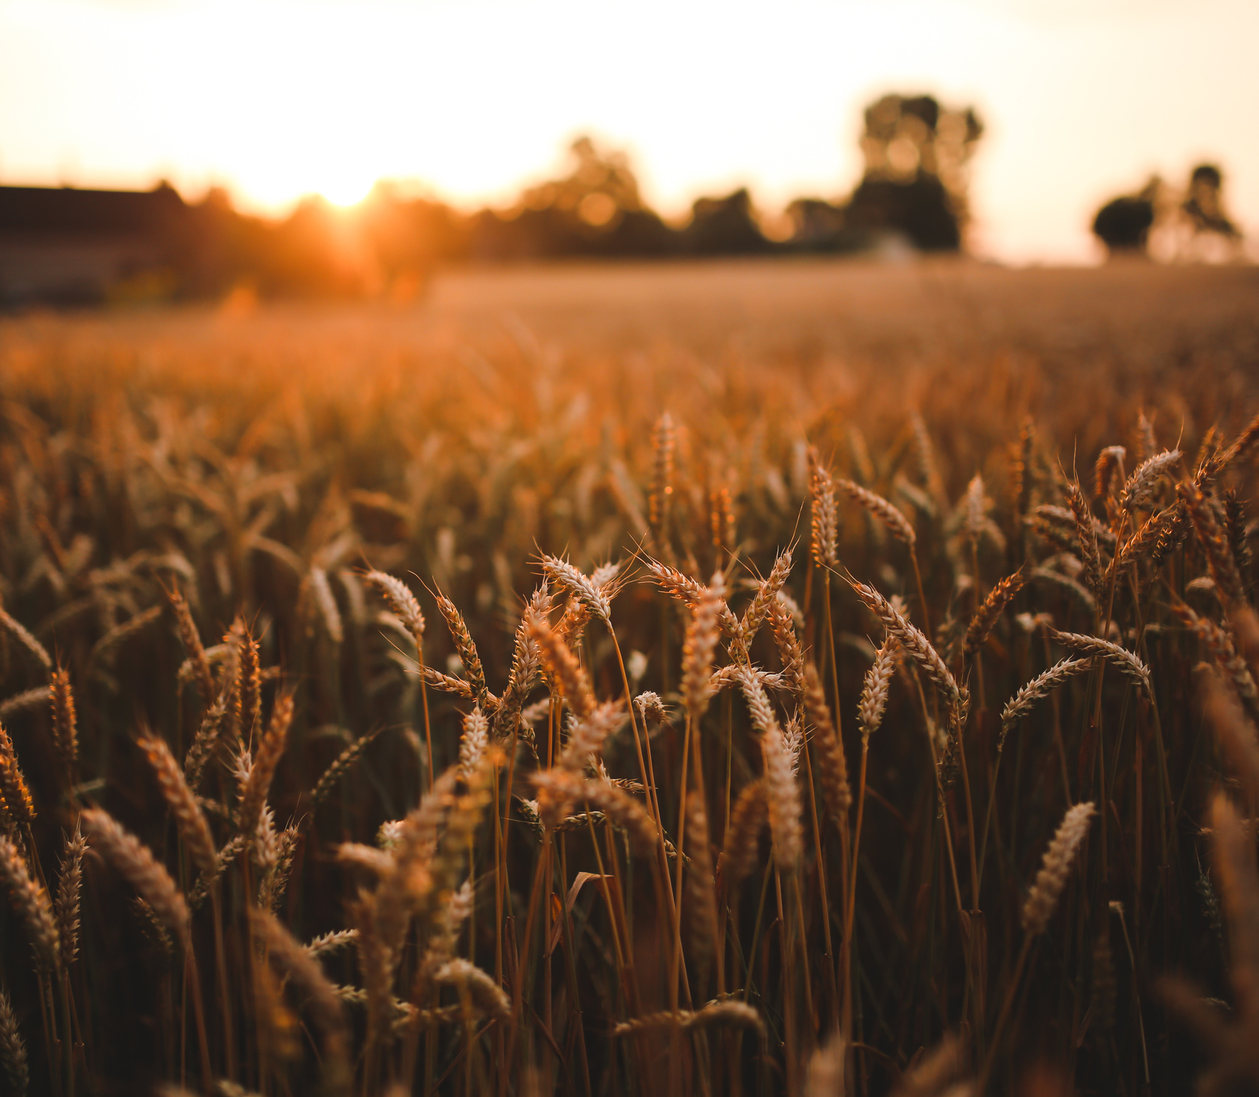
CNN ARCHITECTURE FOR RICE SEED CLASSIFICATION:
The CNN was trained using the following parameters:
Loss Function: Categorical Crossentropy
Optimizer: Adam
Metrics: Accuracy
The model was trained to learn from image data and classify rice seeds into the appropriate categories.
12

Slide 13
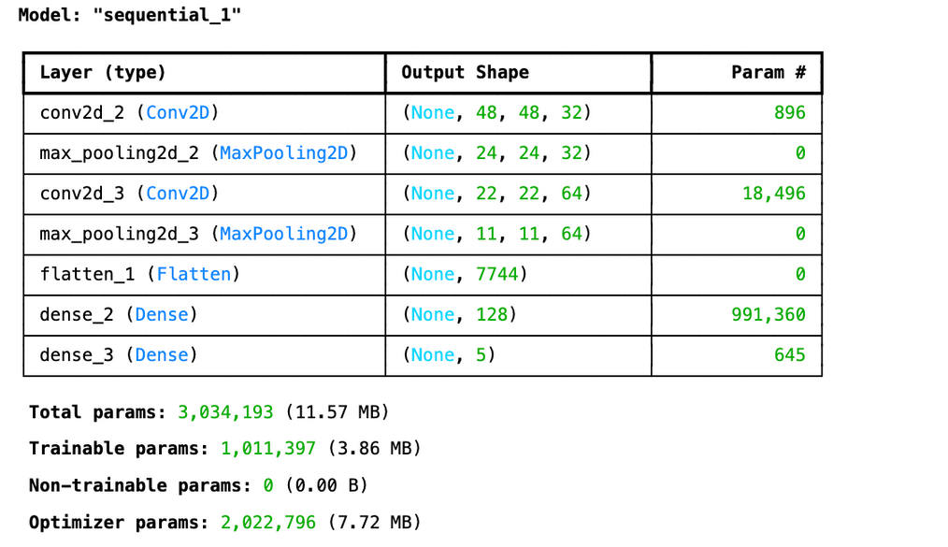
CNN ARCHITECTURE FOR RICE SEED CLASSIFICATION:
Example Architecture:
Conv2D Layer: Applies 32 filters of size (3x3) with ReLU activation.
MaxPooling2D Layer: Reduces the feature map size by taking the maximum value over (2x2) regions.
Conv2D Layer: Applies 64 filters of size (3x3) with ReLU activation.
MaxPooling2D Layer: Reduces the feature map size further.
Flatten Layer: Flattens the 3D feature maps to 1D vector.
Dense Layer: Fully connected layer with 128 units and ReLU activation.
Output Dense Layer: Produces 5 class probabilities using Softmax activation.
13

Slide 14
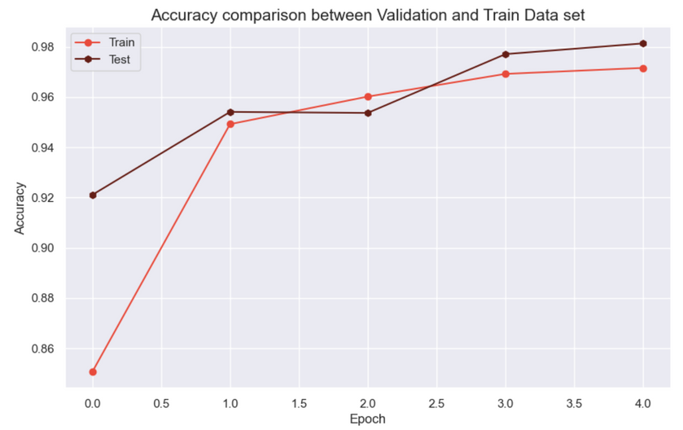
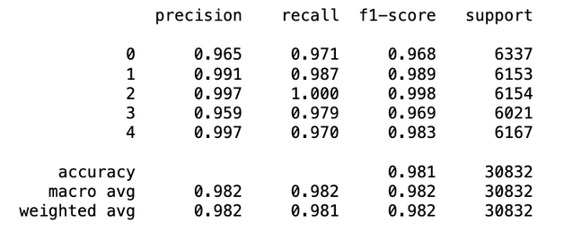
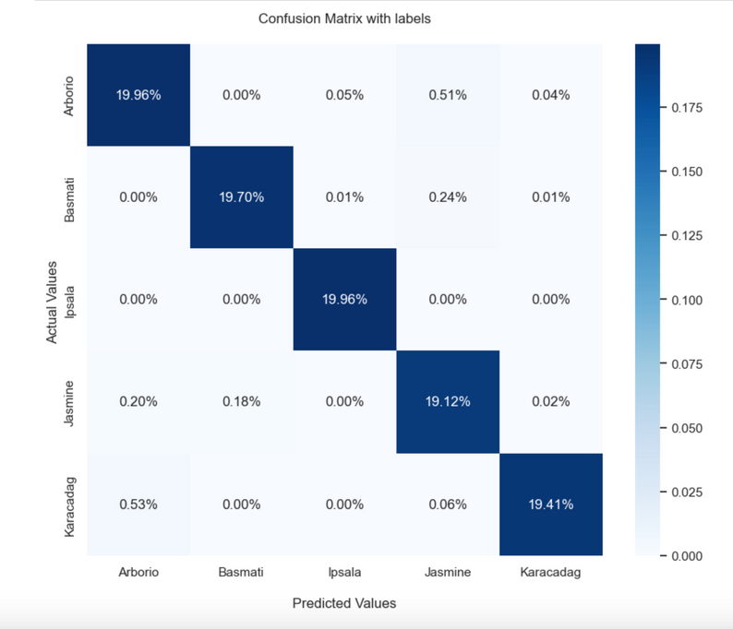
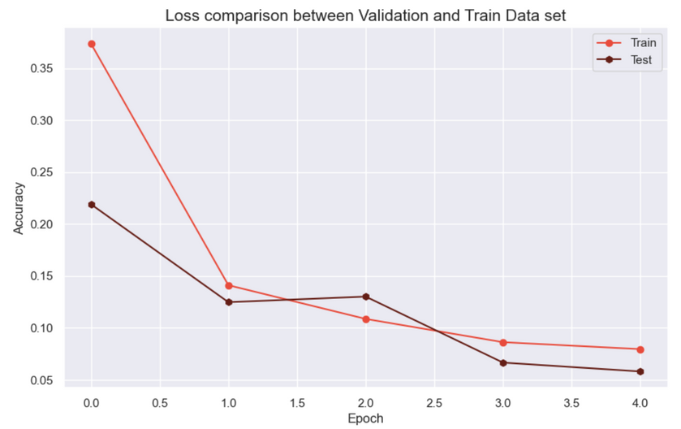
MODEL EVALUATION
The model achieved an accuracy of 98%, demonstrating its effectiveness in classifying rice seeds into the correct categories.
14

Slide 15
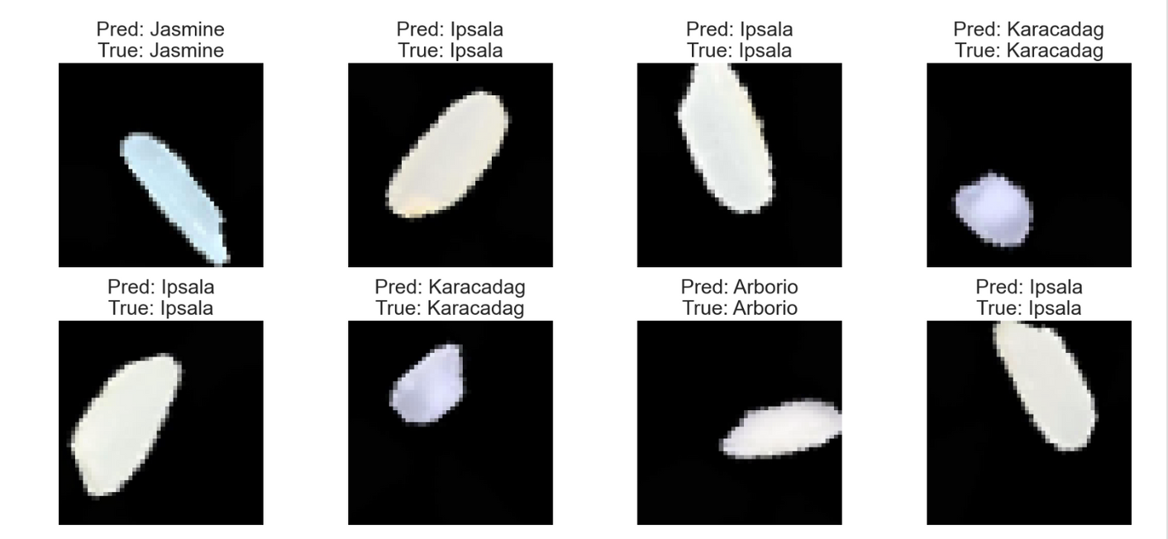
PREDICTIONS
Predictions were made on test images to validate the model's performance. The results were compared with actual labels to assess accuracy and reliability.
15

Slide 16
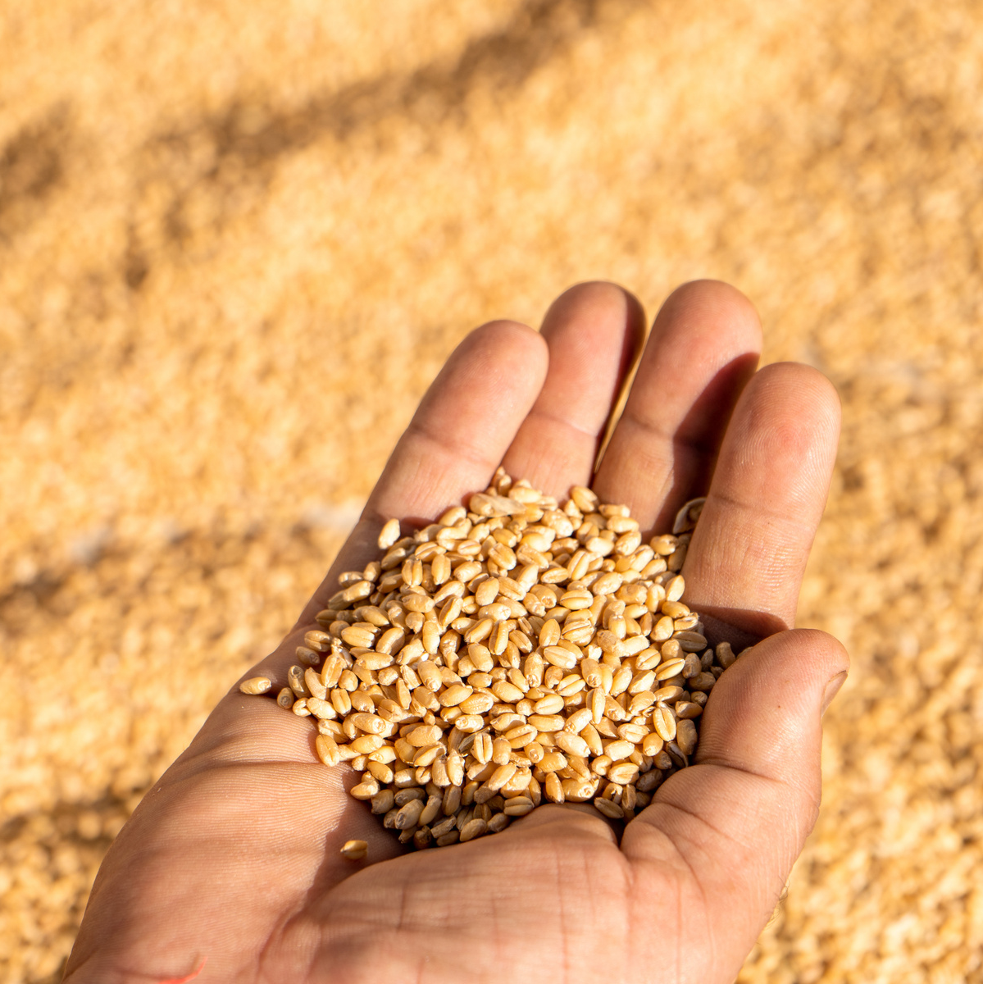
CONCLUSION
Summary:
The rice seed classification model achieved a high accuracy of 98%, demonstrating its effectiveness in distinguishing between different rice varieties.
The use of CNNs and data augmentation significantly contributed to the model’s performance.
Future Work:
Explore additional data augmentation techniques and more complex CNN architectures to further improve accuracy.
Consider incorporating additional features or using transfer learning to enhance model performance.
16

Slide 17
Thank You
https://www.linkedin.com/in/nithya21966/

